Slide 1
Ignorance, Lack of Transparency & High Corruption Risk
Hearing – New Hungarian Nuclear Investment, Paks
March 19th 2015
Room A5E-1, European Parliament, Bruxelles

Slide 2
CRCB
CRCB • Statements • Corruption Risks • Paks: Special Effects • Consequances
The CRCB is a private, non partisan research institute with interdisciplinary staff
The main activities:
data mining, Big Data;
analysis of quality of governance;
measurement and effects of corruption, related to public procurement;
problems of quality of legislation;
Research projects financed by
EU 7th framework program, ANTICORRP;
EU H2020: Digiwhist,
EU Commission, OSI and World Bank

Slide 3
Main statements
CRCB • Statements • Corruption Risks • Paks: Special Effects • Consequances
The Paks Nuclear Power Plant Project (PNPP) is a par excellence Black Box
The lack of transparency accompanies the whole project
The Hungarian Authorities ignore the existence of corruption risks at the PNPP
The corruption risk are / will be very high. The Hungarian authorities manage this project in a highly corrupted business environment. [ + Rosatom].
The high corruption risk results high level of nuclear risks, low level of nuclear safety

Slide 4
Definitions
CRCB • Statements • Corruption Risks • Paks: Special Effects • Consequances
Corruption: abuse of public or private office for personal gain
Grand corruption is the use of powers by government officials / politicians for illegitimate private gain
Corruption Risk: probability of corruption;
Measurement: Corruption Risk Index 0 ≤ CRI ≤ 1

Slide 5
Corruption Risks in general & a priori
CRCB • Statements • Corruption Risks • Paks: Special Effects • Consequances
Megaprojects: complexity, long constuction time; high volume
Nuclear PPs: special, heterogeneous goods
Construction, building: sectorial effects
Great investment projects: the „white elephant” syndrome – [the objective of the project is purely the corruption]

Slide 6
Corruption Risks in general & a priori
CRCB • Statements • Corruption Risks • Paks: Special Effects • Consequances
Markets: non-competitive markets or markets with low level of competition
Market structure - I: oligopoly, oligopsony
Market structure – II.: bilateral monopoly (the contractor has strong power at the demand and also at the supply side)

Slide 7
Historical Evidences
CRCB • Statements • Corruption Risks • Paks: Special Effects • Consequances
Regular cost overruns & price increase
Not meeting the deadlines
Public money losses (unfinished projects)
High corruption => low nuclear safety

Slide 8
Price Increase: 1966-1977, 75 projects
CRCB • Statements • Corruption Risks • Paks: Special Effects • Consequances
Source: Own calculations based on „Energy Information Administration: An Analysis of Nuclear Power Plant Construction Costs, DOE/EIA-0485 (Washington, DC March 1986: p.18) data

Slide 9
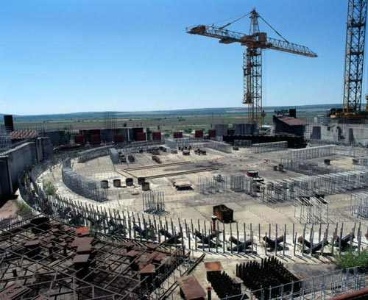
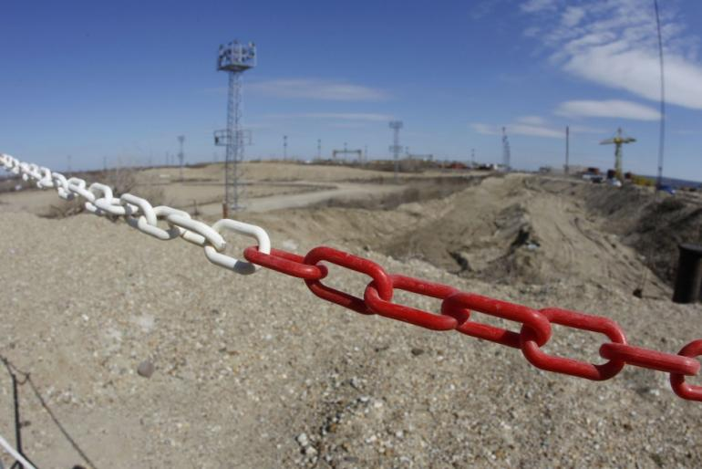
Public Money Losses: Belene
CRCB • Statements • Corruption Risks • Paks: Special Effects • Consequances

Slide 10
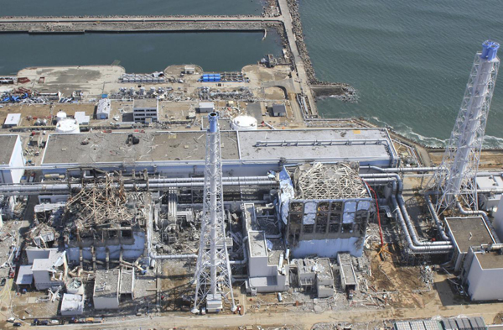
Corruption and Safety: Fukusima
CRCB • Statements • Corruption Risks • Paks: Special Effects • Consequances

Slide 11
Corruption Risks: Special Effects
CRCB • Statements • Corruption Risks • Paks: Special Effects • Consequances
Lack of transparency: without any public consultancy; feasibility study; impact assessment; secrecy; HG classified all contract data for 30 years.
Ignorance of Corruption Risks by the Hungarian Authority
Relation-specific investment: the Russian Gov. finances and the Rosatom builds

Slide 12
Corruption Risks: Special Effects
CRCB • Statements • Corruption Risks • Paks: Special Effects • Consequances
New technology: informational asymmetry
Contractor (Rosatom) cames from a highly corrupted business environment
Hungary: high level of corruption
Megaproject: across ten years PNPP provides the 10% of the total yearly volume of investment in Hungary

Slide 13
Hungarian public procurement data
CRCB • Statements • Corruption Risks • Paks: Special Effects • Consequances
Statistical analysis more than 70.000 public procurements, 2009-2012
Greater projects, higher level of corruption risk
Energy sector: higher level of corruption risk

Slide 14
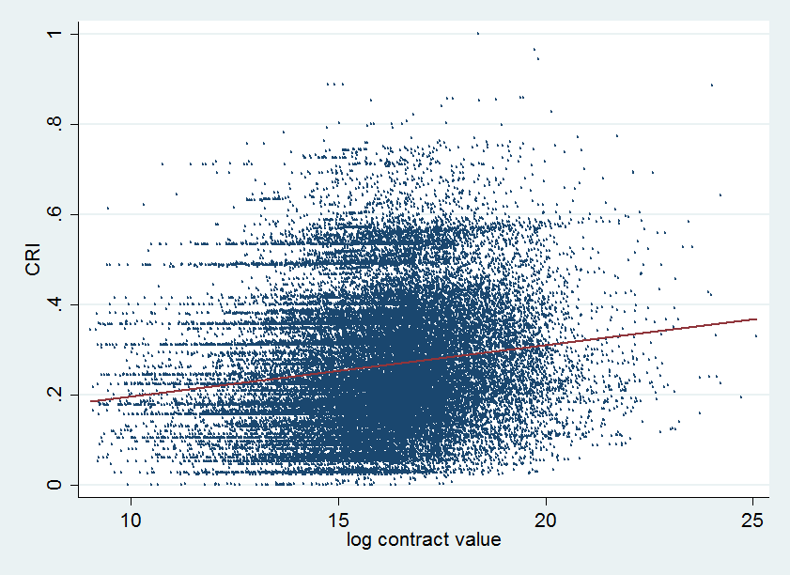
PP contract value & Corruption Risks
CRCB • Statements • Corruption Risks • Paks: Special Effects • Consequances

Slide 15
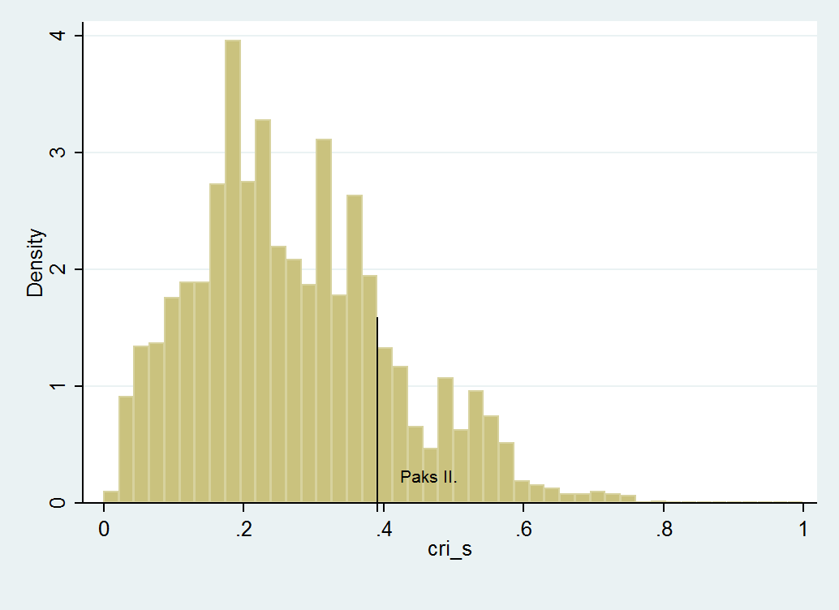
Paks II.: High Corruption Risk
CRCB • Statements • Corruption Risks • Paks: Special Effects • Consequances

Slide 16
Consequances
CRCB • Statements • Corruption Risks • Paks: Special Effects • Consequances
High Corruption Risk, the estimated direct public losses due to corruption: 1,5-2 billion euro
Cost overruns & price increase (public money losses by corruption)
Grand Corruption not excluded
High Corruption Risk, low level of Nuclear Safety

Slide 17
Thank you for your attention!

